Slide 1
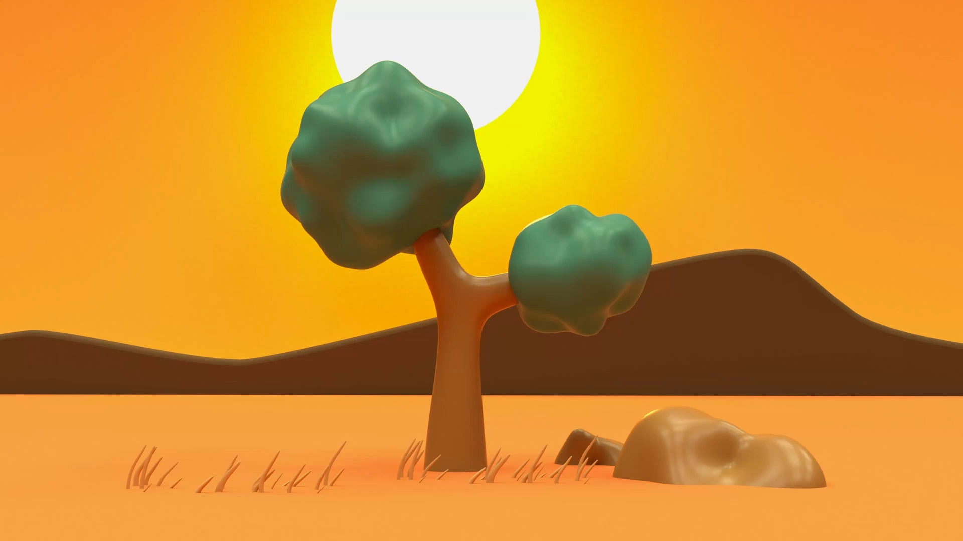
Animation and graphics

Slide 2
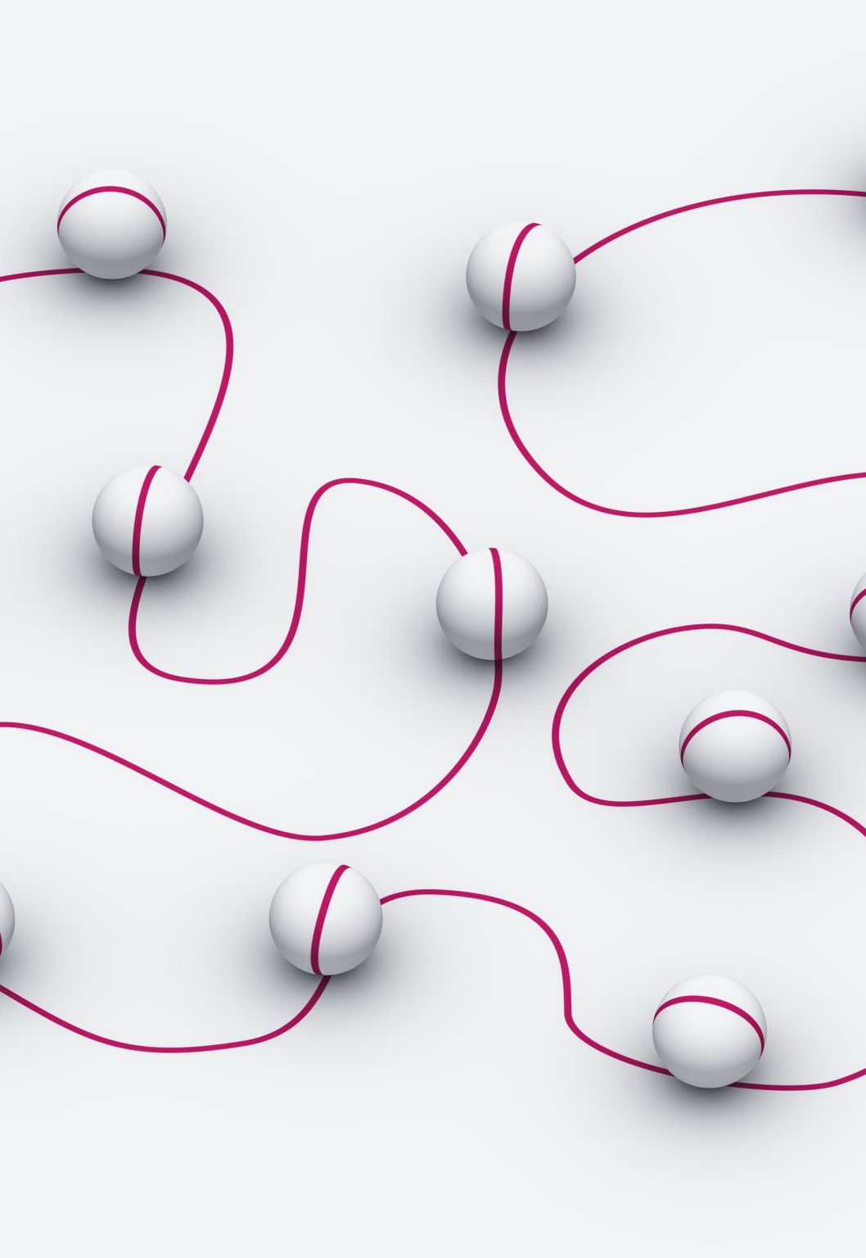
Animation
Android includes the transitions framework, which enables you to easily animate changes between two view hierarchies.
The framework animates the views at runtime by changing some of their property values over time.
The framework includes built-in animations for common effects and lets you create custom animations and transition lifecycle call-backs.

Slide 3
Animate Bitmaps
When you want to animate a bitmap graphic such as an icon or illustration, you should use the drawable animation APIs.
For example, animating a play button transforming into a pause button when tapped is a nice way to communicate to the user that the two actions are related, and that pressing one makes the other visible.

Slide 4
Animate ui visibility and motion
When you need to change the visibility or position of views in your layout, you should include subtle animations to help the user understand how the UI is changing.
To move, reveal, or hide views within the current layout, you can use the property animation system provided by the android.animation package,.
For example, when you change the position properties, the view moves across the screen, or when you change the alpha property, the view fades in or out..

Slide 5
Animate layout changes
You can use the transition framework to create animations when you swap the layout within the current activity or fragment.
All you need to do is specify the starting and ending layout, and what type of animation you want to use.
Then the system figures out and executes an animation between the two layouts.
For example, when the user taps an item to see more information, you can replace the layout with the item details, applying a transition like the one as shown.

Slide 6
Property Animation
A property animation changes a property's (a field in an object) value over a specified length of time.
The android.animation provides classes which handle property animation.
The property animation system lets you define the following characteristics of an animation:
Duration
Time interpolation
Repeat count and behavior
Animator sets
Frame refresh delay

Slide 7
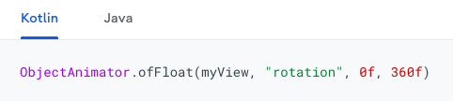
View animation
View Animation is also called as Tween Animation.
The android.view.animation provides classes which handle view animation.
To animate a property of a View object, such as its colour or rotation value, all you need to do is create a property animator and specify the View property that you want to animate.
For example:

Slide 8
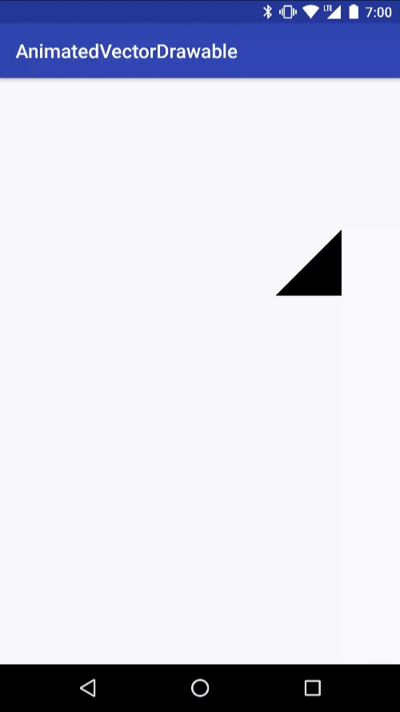
Drawable animation
Drawable animation allows you to specify several static drawable files that will be displayed one at a time to create an animation. The second option is to use an Animated Vector Drawable, which lets you animate the properties of a vector drawable.
The AnimationDrawable class is the basis for Drawable animations.
For Example, this animation works by displaying a running sequence of 'Drawable' resources that is images, frame by frame inside a view object.

Slide 9
Graphics
Graphics are visual representations of the concepts you produce. They give your ideas a pleasing visual presence.
Graphic design is advantageous when generating interactive material with a variety of interesting pictures, especially when using multiple page layouts, typography, visual hierarchy, and photography.
Android graphics provides low level graphics tools such as canvases, colour, filters, points and rectangles which handle drawing to the screen directly.
There are two ways to draw 2D graphics, 1. Draw your animation into a View object from your layout. 2. Draw your animation directly to a Canvas.

Slide 10
Thank You

